Slide 1
Using LLVM For Program Transformation
Andrew Ruef
University of Maryland
Computer science

Slide 2
LLVM Overview
Research project at UIUC
Modular compiler tool chain
Integrated in many open source and commercial projects
Licensed under an open-source license

Slide 3
Introduction

Slide 4
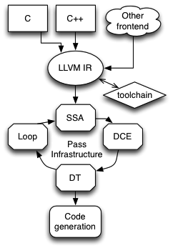
Components of LLVM
Mid-level compiler Intermediate Representation (IR)
C/C++ compiler frontend (clang)
Target-specific (X86, ARM, etc) code generators
Divide between ‘clang’ and ‘LLVM’
Clang is a C/C++ compiler with an LLVM backend
LLVM is ‘everything else’

Slide 5
Todays Agenda
We’ll talk about existing LLVM tools
We’ll do a few demos using those tools
We’ll talk about how to build tools on top of LLVM
We’ll build two analysis tools
We’ll look at a program re-writing tool

Slide 6
Lab: Where we’re going
clang – C language frontend, translates C into LLVM bitcode
opt – Analyze and transform LLVM bitcode
llc – Code generator for LLVM bitcode to native code

Slide 7
Lab: Commands to run
$ clang –c –emit-llvm –o test.bc test.c
$ opt –O1 –o test.bc test.bc
$ llc –o test.s test.bc
$ gcc –o test test.s

Slide 8
Lab: What just happened?
Full translation of C program to executable program
At each stage we can look at what the compiler infrastructure is doing
C to un-optimized bitcode
Optimized bitcode
Machine code
Executable
Very good blog post on the life of an LLVM instruction http://eli.thegreenplace.net/2012/11/24/life-of-an-instruction-in-llvm/

Slide 9
LLVM Intermediate Representation

Slide 10
Lab: Find Non-Constant Format String
Condition to check for:
Any time the first parameter to printf, sprintf (others?) is non-constant, alert for potential security badness
Can we statically detect this in LLVM IR?

Slide 11
Algorithm For Detection
Visit every call instruction in the program
Ask if that call instruction is a format-string accepting routine
If it is, retrieve the first parameter
If the first parameter is not a constant global, raise an alert

Slide 12
Structure of Provided Driver
Very basic driver that uses a PassManager
Reads in LLVM bitcode and runs the VarPrintf pass on it
Produce bitcode file using clang –c –emit-llvm
Using the driver might seem clunky, this is easier than integrating with opt
The pass can later be integrated with opt

Slide 13
Building the drivers
$ cd tutorial
$ mkdir build
$ cd build
$ cmake –DLLVM_ROOT=/usr/local ..
$ make

Slide 14
CMake
CMake is a “meta make”
Why? Why not
CMake generates your build environment
Makefiles
XCode solution
Visual Studio solution
CMake has its own build specification system for describing building code
It might be saner than what you are used to
LLVM can be built with cmake or automake/autoconf

Slide 15
LLVM Intermediate Representation
Language allows for expression of computation
Instructions produce unique values
Collection of statements:
%5 = add nsw i32 %3, %4
%N – a value
add – a binary instruction
nsw – no signed wrap
The language is Static Single Assignment (SSA)
Values defined by statements are never re-defined

Slide 16
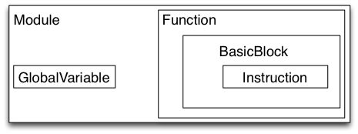
Hierarchy of the Language
A compilation unit is a Module, contains functions
A function is a Function, contains basic blocks
A basic block is a BasicBlock, contains instructions
An instruction is an Instruction
Instructions can contain operands, each is a Value
All of the above, except Module, is a Value

Slide 17
Types
No implicit casting in LLVM IR, all values must be explicitly converted
All values have a static type
Integers are specified at arbitrary bitwidth
i1, i2, i3, … , i32, … i398
Floating point types
Derived types specify arrays, vectors, functions pointers, structures
Structures have types like {i32, i32, i8}
Pointers have types like “pointer to i32”

Slide 18
Note on Integer Types
There are no signed or unsigned integers
LLVM views integers as bit vectors
Frontends destroyed signed/unsigned information
Really, C programmers destroyed signed/unsigned information…
Research prototypes exist that analyze integer wrapping in LLVM IR (http://code.google.com/p/wrapped-intervals/ )
Operations are interpreted as signed or unsigned based on instructions they are used in

Slide 19
Memory Model
LLVM has a low level view of memory
Just a key -> value map
Keys are pointer values
Values stored in LLVM memory must be integers, floating point, pointers, vectors, structures, or arrays
LLVM has a concept of creating function-local memory via alloca

Slide 20
The Module
Highest level concept
Contains a set of global values
Global variables
Functions

Slide 21
The Function
Name
Argument list
Return type
Calling convention
Extends from GlobalValue, has properties of linkage visibility

Slide 22
The BasicBlock
Contains a list of Instructions
All BasicBlocks must end in a TerminatorInst
BasicBlocks descend from values, and are used as values in branching instructions

Slide 23
The Instruction
Terminator instructions
Binary instructions
Bitwise instructions
Aggregate instructions
Memory instructions
Type conversion instructions
Control and misc instructions

Slide 24
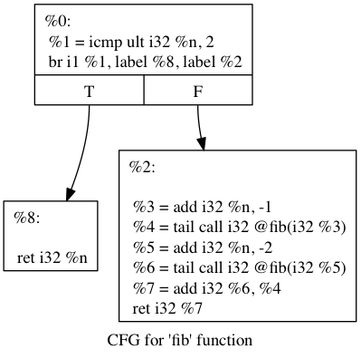
Language By Example
Produced with opt –dot-cfg –o fib.bc fib.bc and graphviz

Slide 25
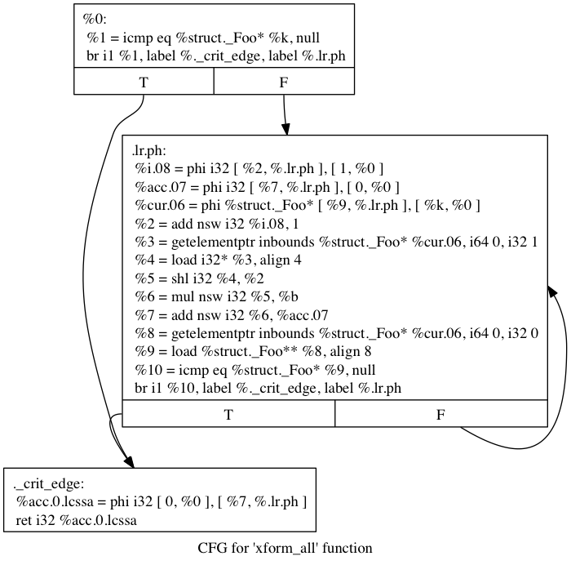
Language By Example, Part 2

Slide 26
Static Single Assignment
LLVM contains a pass to promote variable-using functions to value-using functions
Once transformed by this pass, an LLVM module is in SSA form
Most LLVM analyses and transformations expect to operate on an SSA IR
SSA allows for Def-Use and Use-Def chain analysis

Slide 27
Simple function
int foo(int a, int b) {
int i = a;
int j = b;
return i+j+1;
}

Slide 28
Pre-SSA
define i32 @foo(i32 %a, i32 %b) nounwind uwtable ssp {
entry:
%a.addr = alloca i32, align 4
%b.addr = alloca i32, align 4
%i = alloca i32, align 4
%j = alloca i32, align 4
store i32 %a, i32* %a.addr, align 4
store i32 %b, i32* %b.addr, align 4
%0 = load i32* %a.addr, align 4
store i32 %0, i32* %i, align 4
%1 = load i32* %b.addr, align 4
store i32 %1, i32* %j, align 4
%2 = load i32* %i, align 4
%3 = load i32* %j, align 4
%add = add nsw i32 %2, %3
%add1 = add nsw i32 %add, 1
ret i32 %add1
}

Slide 29
Post-SSA
define i32 @foo(i32 %a, i32 %b) nounwind uwtable ssp {
entry:
%add = add nsw i32 %a, %b
%add1 = add nsw i32 %add, 1
ret i32 %add1
}

Slide 30
The Phi-Node
To support conditional assignments, we introduce an imaginary function
Phi defines a value and accepts a list of tuples as an argument
Each tuple is a (BasicBlock * Value)
Interpret the phi node as defining a value conditionally based on the previous basic block

Slide 31
Phi node example
int foo(int a, int b) {
int r;
if( a > b )
r = a;
else
r = b;
return r;
}

Slide 32
Phi node example, pre SSA
define i32 @foo(i32 %a, i32 %b) nounwind uwtable ssp {
entry:
%a.addr = alloca i32, align 4
%b.addr = alloca i32, align 4
%r = alloca i32, align 4
store i32 %a, i32* %a.addr, align 4
store i32 %b, i32* %b.addr, align 4
%0 = load i32* %a.addr, align 4
%1 = load i32* %b.addr, align 4
%cmp = icmp sgt i32 %0, %1
br i1 %cmp, label %if.then, label %if.else
if.then:
%2 = load i32* %a.addr, align 4
store i32 %2, i32* %r, align 4
br label %if.end
if.else:
%3 = load i32* %b.addr, align 4
store i32 %3, i32* %r, align 4
br label %if.end
if.end:
%4 = load i32* %r, align 4
ret i32 %4
}

Slide 33
Phi node example, post SSA
define i32 @foo(i32 %a, i32 %b) nounwind uwtable ssp {
entry:
%cmp = icmp sgt i32 %a, %b
br i1 %cmp, label %if.then, label %if.else
if.then: br label %if.end
if.else: br label %if.end
if.end: %r.0 = phi i32 [ %a, %if.then ], [ %b, %if.else ]
ret i32 %r.0
}

Slide 34
Phi node example 2
int aa(int a, int b) {
int i = 0;
int k = 0;
while( k < b) {
i += a;
}
return i;
}

Slide 35
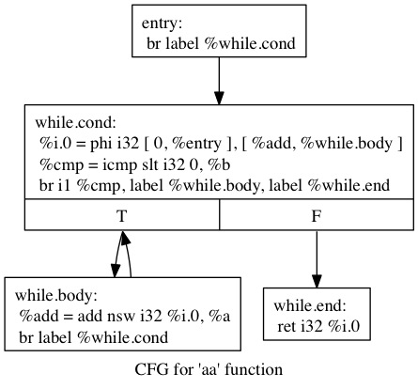
LLVM CFG

Slide 36
The GetElementPtr instruction
An instruction so frequently misunderstood, it has its own documentation page about how it is misunderstood
Frequently abbreviated as GEP
GEP instructions compute offsets from pointer bases
Similar to ‘lea’ instructions in X86 assembler
GEP instructions are type aware
Asking for ‘the 5th field’ of a pointer to structure operand will ‘do the right thing’

Slide 37
Well-Formed LLVM
There are specific rules as to what constitutes “Well-Formed” LLVM
Phi-nodes dominate their uses
Instruction arguments are defined before use
All blocks end in a terminator
All branch targets are defined values
There is an automatic verification pass that will alert when IR is not well formed

Slide 38
C++ API

Slide 39
Value Hierarchy
Value has a very rich class hierarchy
LLVM API allows the manipulation of every Value
Any degree of transformation is possible

Slide 40
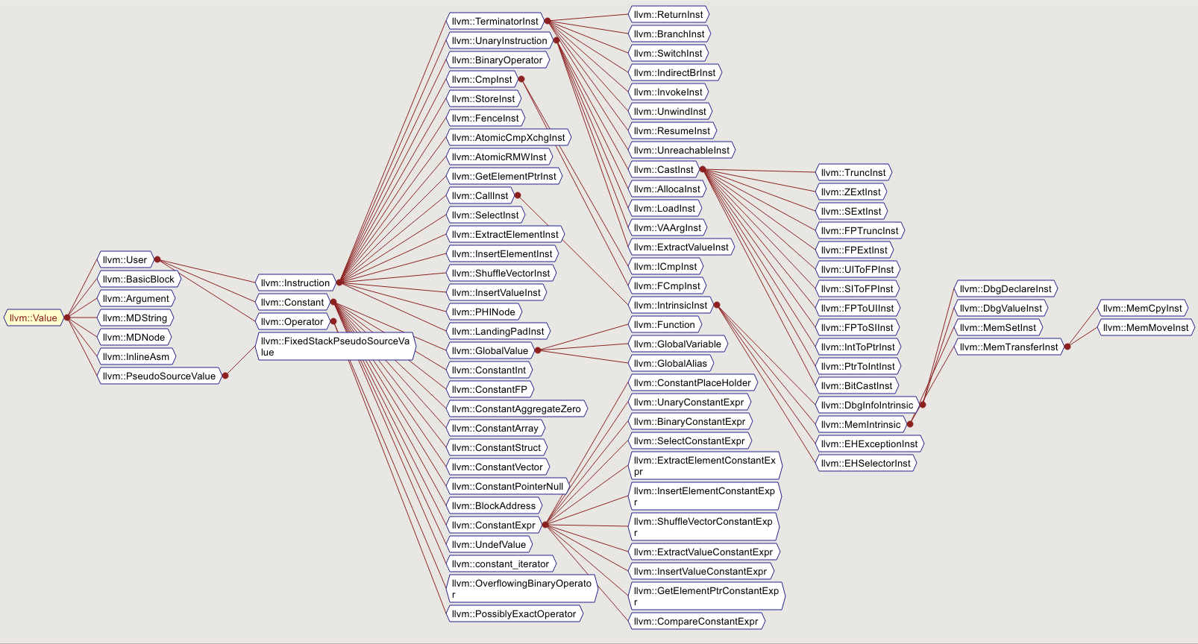
Value class hierarchy

Slide 41
Everything From Value
Every item contained in a Module inherits from Value
This allows for some useful APIs
Def-Use / Use-Def iteration
Replace any Value with another Value
Sub
Allows for classification
Instructions can be UnaryInstructions or BinaryInstructions
GlobalValues can be Functions or GlobalVariables

Slide 42
LLVM Context
Frequent argument to LLVM API functions
These can normally be retrieved from a Value via getContext
There is also a getGlobalContext
The same LLVMContext should always be used across code that interacts with the same Values
LLVM objects are created in a specific context and are unique by pointer values
For example, type objects can be pointer-compared for equality between types of different instructions

Slide 43
Run Time Type Information
An evil C++ concept
If you have a function that accepts a parameter of an abstract class and it could be one of any specific implementations, how to choose?
“Normal” C++ methods
dynamic_cast<T> and friends
Compiler stores information about object types off to the side so that it can be used at run-time

Slide 44
LLVM and Run Time Type Information
The LLVM codebase implements its own RTTI for LLVM objects
When writing passes, you use LLVM specific helpers
isa<T> - True or false if pointer/reference is of type T
cast<T> - “Checked cast”, asserts on failure if not type T
dyn_cast<T> - unchecked cast, null if not type T
The project advises you not to use big chains of these to approximate ‘match’ from ML
Instead they give you a Visitor pattern (yay)
You might find these insufficient (or distasteful)

Slide 45
Common Patterns
“Iterate over BasicBlock in a Function”
Use begin(), end() iterators of Function
“Iterate over Instructions in a Function”
Use inst_iterator
“Iterate over Def-Use chains”
Use use_begin, use_end

Slide 46
InstVisitor
Pattern to avoid giant blocks of
if(T *n = dyn_cast<T>(foo))
Inherit from InstVisitor class and define a visitTInst method
Could work for your purposes
Could confuse control flow even more

Slide 47
Including LLVM In Your Project
llvm-config – executable that will provide useful info about the installed LLVM
Provide paths to headers, library files, etc
If LLVM is built with Cmake, it will add a FindLLVM.cmake to your /usr/share
Compiling your code with –fno-rtti will probably be required
If you compiled LLVM yourself, you can pass LLVM_REQUIRES_RTTI to cmake
Needed if combining boost and llvm

Slide 48
Passes and transformations

Slide 49
Passes
In the previous lab, we wrote a pass
Compiling is the act of passing over and analyzing/transforming IR
Most things that happen in LLVM happen in the context of a pass
Passes can have complicated actions

Slide 50
Pass Dependencies
Passes can depend on the output of other passes
Analysis passes for alias analysis
Passes note their dependencies on other passes
By overriding the getAnalysisUsage method
PassManager figures out the dependency graph
It also attempts to optimize the traversal of the graph
Each Pass returns a bool, PassManager runs until everyone stops

Slide 51
Pass Manager
PassManager performs dependency maintenance
Note that PassManager invocations could be multi-threaded!
Importance of multiple LLVMContexts
PassManager also performs optimizations of pass ordering
PassManager defines different kinds of Passes that can be run
ModulePass – Run on entire module
FunctionPass – Run on individual functions
BasicBlockpass – Run on individual basic blocks

Slide 52
Pass Rules
Non-analysis passes should not ‘remember’ any information about a function or basic block
Analysis passes should remember some information
Otherwise why run them
Transformation passes should be idempotent

Slide 53
Lab: Escape Analysis
If a variable is allocated on the local stack, a pointer to that variable should not outlive the stack
This could happen if a pointer to a local is returned or assigned to a global
clang currently includes a check for this, but the check is kind of busted

Slide 54
Algorithm For Escape Analysis
Populate a set of values that escape the function via return or store
Traverse the set checking for alloca-ed values in the Values descending from the escapes

Slide 55
Structure of Provided Driver
Driver is laid out similarly to before
Collection of tests are included

Slide 56
Projects built on LLVM
Google AddressSanitizer/ThreadSanitizer
http://code.google.com/p/address-sanitizer/
Utah Integer Overflow Checker
http://embed.cs.utah.edu/ioc/
Emscripten, LLVM to Javascript
https://github.com/kripken/emscripten/wiki
Dagger, decompilation from x86 to LLVM
http://llvm.org/devmtg/2013-04/bougacha-slides.pdf

Slide 57
Important LLVM subprojects
poolalloc – field-sensitive, context-sensitive alias analysis
lldb – llvm debugger
klee – symbolic execution for LLVM
FreeBSD compiles with clang, soon will switch to building exclusively with clang

Slide 58
Conclusion
LLVM enables powerful transformations
Includes an “industry grade” C/C++ frontend
clang is default compiler on OSX, supported by Apple
Can compile much of Linux userspace
Well defined Intermediate Language
Modular and pluggable framework for analysis and transformation

Slide 59
Project Documentation
Good documentation online
http://www.llvm.org/docs
Documentation covers many aspects of the LLVM project
Programmers manual details finer points of the C++ API
Language reference is ultimate source for language details and semantics
Relatively responsive IRC channel on OFTC
Active and responsive mailing list

